Slide 1
ECE408 / CS483/CSE408 Spring 2018 Applied Parallel Programming Lecture 27: Joint CUDA-MPI Programming

Slide 2
Objective
To be familiar with simple MPI-CUDA heterogeneous applications
Understand the key sections of an MPI application
Communication in distributed computing applications
Generalizing ECE408 concepts to other parallel programming APIs

Slide 3
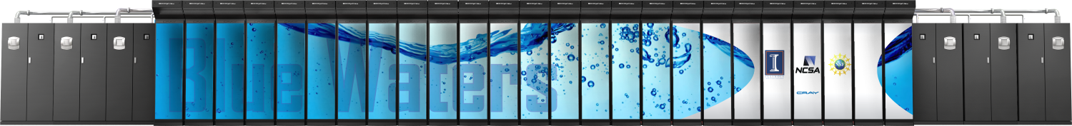
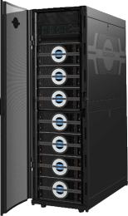
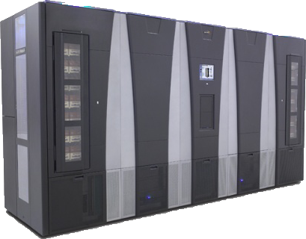
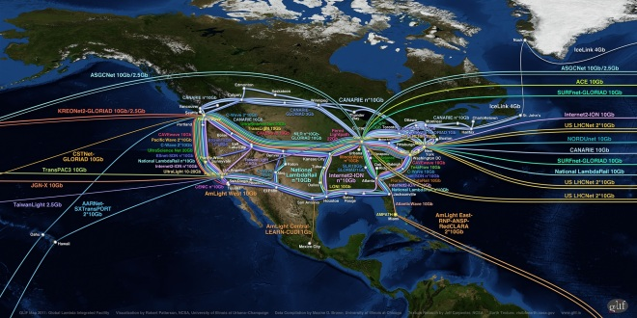
Blue Waters Computing System
IB Switch
>1 TB/sec
10/40/100 Gb
Ethernet Switch
100 GB/sec
300+ Gb/sec
WAN
Spectra Logic: 300 PBs
Sonexion: 26 PBs
Notes:
Note just compute – main memory (1.6PB); Disk (26PB); near line (300PB)

Slide 4
Blue Waters and Titan Computing Systems
NCSA ORNL
System Attribute Blue Waters Titan
Vendors Cray/AMD/NVIDIA Cray/AMD/NVIDIA
Processors Interlagos/Kepler Interlagos/Kepler
Total Peak Performance (PF) 11.1 27.1
Total Peak Performance (CPU/GPU) 7.1/4 2.6/24.5
Number of CPU Chips 48,352 18,688
Number of GPU Chips 3,072 18,688
Amount of CPU Memory (TB) 1511 584
Interconnect 3D Torus 3D Torus
Amount of On-line Disk Storage (PB) 26 13.6
Sustained Disk Transfer (TB/sec) >1 0.4-0.7
Amount of Archival Storage 300 15-30
Sustained Tape Transfer (GB/sec) 100 7

Slide 5

Gemini Interconnect Network
Blue Waters
3D Torus Size
23 x 24 x 24
InfiniBand
Login
Servers
Network(s)
GigE
SMW
Y
Fibre Channel
X
Boot Raid
Z
Infiniband
Interconnect
Network
Lustre
Compute Nodes
Service Nodes
Cray XE6 Compute
Operating System
Login/Network
Cray XK7 Accelerator
Boot
Login Gateways
System Database
Network
Lustre File System
LNET Routers
Notes:
Note mixed elements in Torus; note complexity in assigning blocks of processes to Torus.

Slide 6
Science Area | Number of Teams | Codes | Struct Grids | Unstruct Grids | Dense Matrix | Sparse Matrix | N-Body | Monte Carlo | FFT | PIC | Significant I/O
Climate and Weather | 3 | CESM, GCRM, CM1/WRF, HOMME | X | X |  | X |  | X |  |  | X
Plasmas/Magnetosphere | 2 | H3D(M),VPIC, OSIRIS, Magtail/UPIC | X |  |  |  | X |  | X |  | X
Stellar Atmospheres and Supernovae | 5 | PPM, MAESTRO, CASTRO, SEDONA, ChaNGa, MS-FLUKSS | X |  |  | X | X | X |  | X | X
Cosmology | 2 | Enzo, pGADGET | X |  |  | X | X
Combustion/Turbulence | 2 | PSDNS, DISTUF | X |  |  |  |  |  | X
General Relativity | 2 | Cactus, Harm3D, LazEV | X |  |  | X
Molecular Dynamics | 4 | AMBER, Gromacs, NAMD, LAMMPS |  |  |  | X | X |  | X
Quantum Chemistry | 2 | SIAL, GAMESS, NWChem |  |  | X | X | X | X |  |  | X
Material Science | 3 | NEMOS, OMEN, GW, QMCPACK |  |  | X | X | X | X
Earthquakes/Seismology | 2 | AWP-ODC, HERCULES, PLSQR, SPECFEM3D | X | X |  |  | X |  |  |  | X
Quantum Chromo Dynamics | 1 | Chroma, MILC, USQCD | X |  | X | X
Social Networks | 1 | EPISIMDEMICS
Evolution | 1 | Eve
Engineering/System of Systems | 1 | GRIPS,Revisit |  |  |  |  |  | X
Computer Science | 1 |  |  | X | X | X |  |  | X |  | X

Slide 7










Cray XK7 Nodes
Dual-socket Node
One AMD Interlagos chip
8 core modules, 32 threads
156.5 GFs peak performance
32 GBs memory
51 GB/s bandwidth
One NVIDIA Kepler chip
1.3 TFs peak performance
6 GBs GDDR5 memory
250 GB/sec bandwidth
Gemini Interconnect
Same as XE6 nodes
PCIe Gen2
HT3
HT3
Blue Waters contains 4,224 Cray XK7 compute nodes.

Slide 8
CUDA-based cluster
Each node contains N GPUs
GPU 0
…
GPU N
GPU 0
…
GPU N
PCIe
PCIe
PCIe
PCIe
CPU 0
…
CPU M
CPU 0
…
CPU M
Host Memory
Host Memory

Slide 9
MPI Model
Many processes distributed in a cluster
Each process computes part of the output
Processes communicate with each other through message passing (not global memory)
Processes can synchronize through messages
Node
Node
Node
Node

Slide 10
MPI Initialization, Info
User launches an MPI job with X processes by executing in the command shell
MPIrun –np X
int MPI_Init(int *argc, char ***argv)
Initialize MPI
MPI_COMM_WORLD
MPI group formed with all allocated nodes
int MPI_Comm_rank(MPI_Comm comm, int *rank)
Rank of the calling process in group of comm
int MPI_Comm_size(MPI_Comm comm, int *size)
Number of processes in the group of comm

Slide 11
Vector Addition: Main Process
int main(int argc, char *argv[]) {
int vector_size = 1024 * 1024 * 1024;
int pid=-1, np=-1;
MPI_Init(&argc, &argv);
MPI_Comm_rank(MPI_COMM_WORLD, &pid);
MPI_Comm_size(MPI_COMM_WORLD, &np);
if(np < 3) {
if(0 == pid) printf(“Nedded 3 or more processes.\n");
MPI_Abort( MPI_COMM_WORLD, 1 ); return 1;
}
if(pid < np - 1)
compute_node(vector_size / (np - 1));
else
data_server(vector_size);
MPI_Finalize();
return 0;
}

Slide 12
MPI Sending Data
int MPI_Send(void *buf, int count, MPI_Datatype datatype, int dest, int tag, MPI_Comm comm)
buf: Starting address of send buffer
count: Number of elements in send buffer (nonnegative integer)
datatype: Datatype of each send buffer element
dest: Rank of destination (integer)
tag: Message tag (integer)
comm: Communicator (handle)

Slide 13
MPI Sending Data
int MPI_Send(void *buf, int count, MPI_Datatype datatype, int dest, int tag, MPI_Comm comm)
Buf: Initial address of send buffer
Count: Number of elements in send buffer (nonnegative integer)
Datatype: Datatype of each send buffer element
Dest: Rank of destination (integer)
Tag: Message tag (integer)
Comm: Communicator (handle)
Node
Node
Node
Node

Slide 14
MPI Receiving Data
int MPI_Recv(void *buf, int count, MPI_Datatype datatype, int source, int tag, MPI_Comm comm, MPI_Status *status)
Buf: Starting address of receive buffer
Count: Maximum number of elements in receive buffer (non-negative integer)
Datatype: Datatype of each receive buffer element
Source: Rank of source (integer)
Tag: Message tag (integer)
Comm: Communicator (handle)
Status: Status object

Slide 15
MPI Receiving Data
int MPI_Recv(void *buf, int count, MPI_Datatype datatype, int source, int tag, MPI_Comm comm, MPI_Status *status)
Buf: Initial address of receive buffer
Count: Maximum number of elements in receive buffer (non-negative integer)
Datatype: Datatype of each receive buffer element
Source: Rank of source (integer)
Tag: Message tag (integer)
Comm: Communicator (handle)
Status: Status object (Status)
Node
Node
Node
Node

Slide 16
Vector Addition: Server Process (I)
void data_server(unsigned int vector_size) {
int np, num_nodes = np – 1, first_node = 0, last_node = np - 2;
unsigned int num_bytes = vector_size * sizeof(float);
float *input_a = 0, *input_b = 0, *output = 0;
/* Set MPI Communication Size */
MPI_Comm_size(MPI_COMM_WORLD, &np);
/* Allocate input data */
input_a = (float *)malloc(num_bytes);
input_b = (float *)malloc(num_bytes);
output = (float *)malloc(num_bytes);
if(input_a == NULL || input_b == NULL || output == NULL) {
printf(“Server couldn't allocate memory\n");
MPI_Abort( MPI_COMM_WORLD, 1 );
}
/* Initialize input data */
random_data(input_a, vector_size , 1, 10);
random_data(input_b, vector_size , 1, 10);

Slide 17
Vector Addition: Server Process (II)
/* Send data to compute nodes */
float *ptr_a = input_a;
float *ptr_b = input_b;
for(int process = 1; process < last_node; process++) {
MPI_Send(ptr_a, vector_size / num_nodes, MPI_FLOAT,
process, DATA_DISTRIBUTE, MPI_COMM_WORLD);
ptr_a += vector_size / num_nodes;
MPI_Send(ptr_b, vector_size / num_nodes, MPI_FLOAT,
process, DATA_DISTRIBUTE, MPI_COMM_WORLD);
ptr_b += vector_size / num_nodes;
}

Slide 18
Vector Addition: Server Process (III)
/* Wait for compute to complete*/
MPI_Barrier(MPI_COMM_WORLD);
/* Collect output data */
MPI_Status status;
for(int process = 0; process < num_nodes; process++) {
MPI_Recv(output + process * num_points / num_nodes,
num_points / num_comp_nodes, MPI_REAL, process,
DATA_COLLECT, MPI_COMM_WORLD, &status );
}
/* Store output data */
store_output(output, dimx, dimy, dimz);
/* Release resources */
free(input);
free(output);
}

Slide 19
Vector Addition: Compute Process (I)
void compute_node(unsigned int vector_size ) {
int np;
unsigned int num_bytes = vector_size * sizeof(float);
float *input_a, *input_b, *output;
MPI_Status status;
MPI_Comm_size(MPI_COMM_WORLD, &np);
int server_process = np - 1;
/* Alloc host memory */
input_a = (float *)malloc(num_bytes);
input_b = (float *)malloc(num_bytes);
output = (float *)malloc(num_bytes);
/* Get the input data from server process */
MPI_Recv(input_a, vector_size, MPI_FLOAT, server_process,
DATA_DISTRIBUTE, MPI_COMM_WORLD, &status);
MPI_Recv(input_b, vector_size, MPI_FLOAT, server_process,
DATA_DISTRIBUTE, MPI_COMM_WORLD, &status);

Slide 20
Vector Addition: Compute Process (II)
/* Compute the partial vector addition */
for(int i = 0; i < vector_size; ++i) {
output[i] = input_a[i] + input_b[i];
}
/* Or, can offload to GPU here */
/* cudaMalloc(), cudaMemcpy(), kernel launch, etc. */
MPI_Barrier(MPI_COMM_WORLD);
/* Send the output */
MPI_Send(output, vector_size, MPI_FLOAT,
server_process, DATA_COLLECT, MPI_COMM_WORLD);
/* Release memory */
free(input_a);
free(input_b);
free(output);
}

Slide 21
Current Trends
GPU Direct
MPI_Send and MP_Receive deals directly with GPU memory
Requires support from NIC vendors
Host Memory
CPU
NIC
NIC
CPU
Host Memory
GPU
GPU
Device Memory
Device Memory

Slide 22
Questions?

